Slide 1
DANA 4840
Classification II
Part IV Cluster Validation Statistics
Part 1 – Rand Index and Adjusted Rand Index

Slide 2
Cluster Validation Statistics
Cluster Validation Statistics: one use is to compare which of several clustering results is better
Cluster validation can be divided into (a) internal cluster validation and (b) external cluster validation.
Internal cluster validation (using only data used in the clustering)
i) silhouette method (already covered) [average of all silhouette scores]
ii) Dunn index (to be covered next week or two)
External cluster validation (using data outside of what is used in the clustering).
i) Rand index (and adjusted Rand index) [covered today in this lecture]
ii) there are other approaches such as Meila’s VI (variation of information) – not covered in this course
An example of external cluster validation is the Iris dataset (ground truth is Species which tells us which group an observation should belong to).

Slide 3
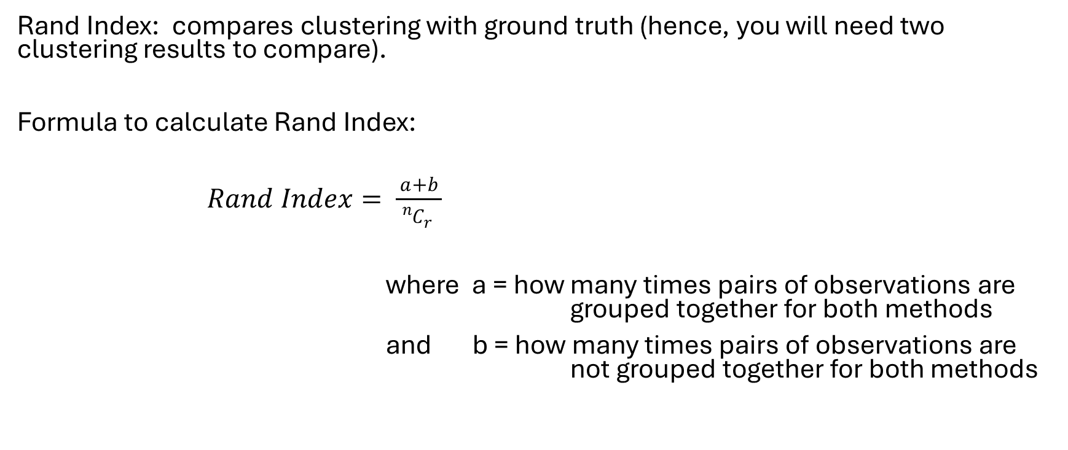
Rand index:
Rand Index: compares clustering with ground truth (hence, you will need two clustering results to compare).
Formula to calculate Rand Index:
$Rand Index= \frac{a+b}{{{}_{}^{n}C}_{r}^{}}$
where a = how many times pairs of observations are grouped together for both methods
and b = how many times pairs of observations are not grouped together for both methods

Slide 4
Example:
4 observations : A, B, C, D
Ground truth: (1, 1, 2, 2) ← this means (AB) (CD) are the two clusters
Your clustering results: (1, 1, 1, 2) ←write down what this means:
Calculate Rand Index.
Students to write down solution:

Slide 5
Weakness of Rand Index:
When we generate clustering result by “chance” (that is, assign observations randomly to groups) – chances are, the values of a and b are not 0.
Hence, the Rand Index will not be 0 even when logically, we hope its value will be 0 when observations are randomly assigned to groups.
Solution to get around this weakness: Use Adjusted Rand Index. See worksheet for details.

